Slide 1
Queues

Slide 2
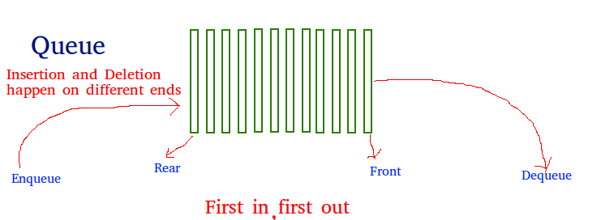

Slide 3
Queue is a list-like structure that provides restricted access to its elements.
Queue elements may only be inserted at the back (called an enqueue operation) and removed from the front (called a dequeue operation).
Queues operate like standing in line at a movie theater ticket counter.
If nobody cheats, then newcomers go to the back of the line. The person at the front of the line is the next to be served.
Thus, queues release their elements in order of arrival.

Slide 4
Stores, theaters, reservation centers, and other similar services typically process customer requests according to the FIFO principle.
A queue would therefore be a logical choice for a data structure to handle calls to a customer service center, or a wait-list at a restaurant.
FIFO queues are also used by many computing devices, such as a networked printer, or a Web server responding to requests.

Slide 5
The Queue Abstract Data Type defines a collection that keeps objects in a sequence, where element access and deletion are restricted to the first element in the queue, and element insertion is restricted to the back of the sequence.
This restriction enforces the rule that items are inserted and deleted in a queue according to the first-in, first-out (FIFO) principle.
The queue abstract data type (ADT) supports the following two update methods:
enqueue(e): Adds element e to the back of queue.
dequeue( ): Removes and returns the first element from the queue (or null if the queue is empty).

Slide 6
Overflow State: A queue may be implemented to have a bounded capacity.
If the queue is full and does not contain enough space to accept an entity to be pushed, the queue is then considered to be in an overflow state.
Underflow State: The dequeue operation removes an item from the top of the queue.
A dequeue operation either reveals previously concealed items or results in an empty queue, but, if the queue is empty, it goes into underflow state, which means no items are present in queue to be removed.
front: Returns the item at the front of the queue.

Slide 7
Accountants have used queues since long before the existence of computers.
They call a queue a “FIFO” list, which stands for “First-In, First-Out.”
There are two implementations for queues:
Array-based queue
Linked queue.
Time Complexity:
Time complexity of all operations like enqueue(), dequeue(), isFull(), isEmpty(), front() and rear() is O(1).
There is no loop in any of the operations.

Slide 8
Example
Operation Output Q
enqueue(5) – (5)
enqueue(3) – (5, 3)
dequeue() 5 (3)
enqueue(7) – (3, 7)
dequeue() 3 (7)
first() 7 (7)
dequeue() 7 ()
dequeue() null ()
isEmpty() true ()
enqueue(9) – (9)
enqueue(7) – (9, 7)
size() 2 (9, 7)
enqueue(3) – (9, 7, 3)
enqueue(5) – (9, 7, 3, 5)
dequeue() 9 (7, 3, 5)

Slide 9
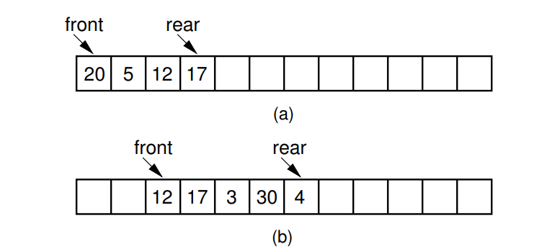
Array-Based Queues
A simple conversion of the array-based list implementation is not efficient.
After repeated use, elements in the array-based queue will drift to the back of the array.
(a) The queue after the initial four numbers 20, 5, 12, and 17 have been inserted.
(b) The queue after elements 20 and 5 are deleted, following which 3, 30, and 4 are inserted.

Slide 10
This implementation raises a new problem.
Assume that the front element of the queue is initially at position 0, and that elements are added to successively higher-numbered positions in the array.
When elements are removed from the queue, the front index increases.
Over time, the entire queue will drift toward the higher-numbered positions in the array.
Once an element is inserted into the highest-numbered position in the array, the queue has to run out of space.

Slide 11
This happens despite the fact that, there might be free positions at the low end of the array where elements have previously been removed from the queue.
The “drifting queue” problem can be solved by pretending that the array is circular and so allow the queue to continue directly from the highest-numbered position in the array to the lowest-numbered position.
This is easily implemented through use of the modulus operator (denoted by % in Java).
In this way, positions in the array are numbered from 0 through size−1, and position size−1 is defined to immediately preceded position 0 (which is equivalent to position size % size).

Slide 12
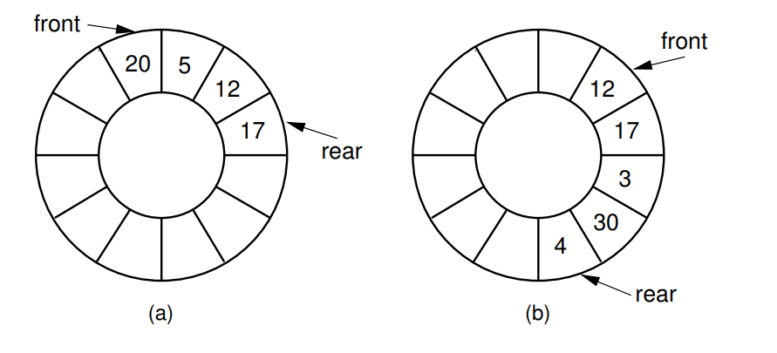
The circular queue with array positions increasing in the clockwise direction.
(a) The queue after the initial four numbers 20, 5, 12, and 17 have been inserted.
(b) The queue after elements 20 and 5 are deleted, following which 3, 30, and 4 are inserted.

Slide 13
There remains one more serious, though subtle, problem to the array-based queue implementation.
How can we recognize when the queue is empty or full?
Assume that front stores the array index for the front element in the queue, and rear stores the array index for the rear element.
If both front and rear have the same position, then with this scheme there must be one element in the queue.
Thus, an empty queue would be recognized by having rear be one less than front (taking into account the fact that the queue is circular, so position size−1 is actually considered to be one less than position 0).

Slide 14
What is the situation when a queue with n array positions available contains n elements?
In this case, if the front element is in position 0, then the rear element is in position size−1.
This means that the value for rear is one less than the value for front when the circular nature of the queue is taken.
In other words, the full queue is indistinguishable from the empty queue!

Slide 15
Array-based queue implementation
ListArray holds the queue elements, and as usual, the queue constructor allows an optional parameter to set the maximum size of the queue.
The array created is actually large enough to hold one element more than the queue will allow, so that empty queues can be distinguished from full queues.
Member maxSize is used to control the circular motion of the queue.
Member rear is set to the position of the current rear element, while front is the position of the current front element.

Slide 16
In this implementation, the front of the queue is defined to be toward the lower numbered positions in the array (in the counter-clockwise direction), and the rear is defined to be toward the higher-numbered positions.
Thus, enqueue increments the rear pointer (modulus size), and dequeue increments the front pointer.
Implementation of all member functions is straightforward.

Slide 17
Linked Queues
The linked queue implementation is a straightforward adaptation of the linked list.
Methods front and rear are pointers to the front and rear queue elements, respectively.
We will use a header link node, which allows for a simpler implementation of the enqueue operation by avoiding any special cases when the queue is empty.

Slide 18
On initialization, the front and rear pointers will point to the header node, and front will always point to the header node while rear points to the true last link node in the queue.
Method enqueue places the new element in a link node at the end of the linked list (i.e., the node that rear points to) and then advances rear to point to the new link node.
Method dequeue removes and returns the first element of the list.

Slide 19
Comparison of Array-Based and Linked Queues
All member functions for both the array-based and linked queue implementations require constant time.
The space comparison issues are the same as for the equivalent stack implementations.
Unlike the array-based stack implementation, there is no convenient way to store two queues in the same array, unless items are always transferred directly from one queue to the other.

